Slide 1
Signals
Inter process mechanism in Linux system
- Jayaraj P B

Slide 2
What is signals
In short: Signals are a way of sending simple messages to processes.
Signals are usually used by the operating system to notify processes that some event occurred, without these processes needing to poll for the event.

Slide 3
Definition : Signals
A signal is an asynchronous event which is delivered to a process.
Asynchronous means that the event can occur at any time
may be unrelated to the execution of the process
e.g. user types ctrl-C, when the system hangs

Slide 4
Linux Signals
A LINUX signal corresponds to an event
It is raised by one process (or OS) to call another process’s attention to an event
It can be caught (or ignored) by the subject process

Slide 5
More on Signals
LINUX has a fixed set of signals
signal.h defines the signals in the OS
Each LINUX signal has an integer number and a symbolic name Defined in <signal.h>

Slide 6

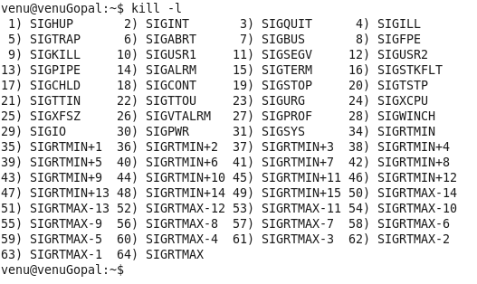
The command ‘kill –l’ lists all the signals that are available.
Notes:
The list of all available signals can be found from kill –l command.
Among the list, some of them are
SIGINT: This signal is generated, when a ctrl+c is given through the keyboard.
SIGSEGV: This is generated when there is some segmentation problem, related to memory
SIGPIPE: if the reading end of a pipe is closed and we are writing at the other write pipe end
SIGCHLD: This signal is sent by the child process to its parent before exiting
SIGSTOP: This signal is generated by ctrl-z

Slide 7
Signals
Most signals have predefined meanings:
sighup (HangUp): when a terminal is closed, the
hangup signal is sent to every process in control terminal.
sigint(interrupt): ask politely a process to terminate.
sigquit(quit): ask a process to terminate and produce a
core dump.
sigkill (kill): force a process to terminate.

Slide 8
Signal Sources
terminal driver
memory management
shell command
SIGINT
SIGHUP
SIGQUIT
SIGKILL
kernel
SIGPIPE
SIGWINCH
SIGALRM
window manager
a process
SIGUSR1
other user processes

Slide 9
Sending signals to process. (by keyboard)
Ctrl-c
This causes the system to send an INT signal
(SIGINT) to the running process which causes
The process to immediately terminates.
Ctrl-z
This causes the system to send an TSTP signal(SIGTSTP) to the running process this causes The process to Suspend execution.
Ctrl-\
This is same as ctrl-c but with better flexibility
This sends ABRT Signal (SIGABRT)

Slide 10
Signal transmission
The mechanics consist of two distinct steps:
Signal Generation: The kernel updates data structure of the destination process to represent that a new signal has been sent.
Signal delivery: The kernel forces the destination process to react to the signal by changing its execution state, by starting the execution of a specified signal handler.

Slide 11
Delivering a Signal
Actions performed upon Delivering a Signal
1. Explicitly ignore the signal
2. Execute the default action associated with the signal
3. Catch the signal by invoking a user defined signal handler function

Slide 12
Ignoring the signal
Do_signal() simply continues with a new execution of the loop.
ka= &current->sig->action[signr-1];
If (ka->sa.sa_handler== SIG_IGN )
Continue ;

Slide 13
Default action for the signal
Execute the default action associated with the signal
The important actions are (based on signal type)
Terminate (kill)
Dump (core file for execution context is created)
Ignore (signal is ignored)
Stop (process is stopped.

Slide 14
Pre-defined Signal Handlers
There are two pre-defined signal handler functions that we can use, instead of writing our own:
SIG_IGN: Causes the process to ignore the specified signal. For example, in order to ignore Ctrl-C completely, write this: signal(SIGINT, SIG_IGN);
SIG_DFL: Causes the system to set the default signal handler for the given signal signal(SIGTSTP, SIG_DFL);

Slide 15
Executing the default action for the signal
The signals whose default action is stop may stop all processes in the thread group
The signals whose default action is dump may create a core file in the process working directory.
The default action of terminate is simply killing the process.

Slide 16
Catching the signal
If a handler has been established for the signal, do_signal() function must enforces its execution.
Signal handlers are functions defined by User mode processes and included in the User mode Segment.
Handle_signal() function runs in kernel mode while signal handlers run in user mode.

Slide 17
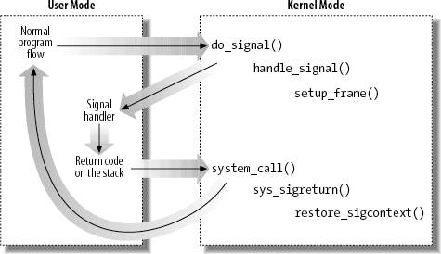
Catching the signal

Slide 18
Signal Handling
Use the signal handling library: signal.h
Then can use the signal call:
#include <signal.h>
void (*signal( int sig, void (*handler)(int)));
signal returns a pointer to the PREVIOUS signal handler
#include <signal.h>
Signal (SIGINT, handler);

Slide 19
System calls related to signal handling
Kill() - sys call send signals to processes
kill(pid, sig)
#include<sys/types.h>
#include<signal.h>
Int kill (pid_t pid, int sig)
//returns 0 on success -1 on fail
Sample programs

Slide 20
Summary
A signal is an asynchronous event which is delivered to a process
Signals are a way of sending simple messages to processes
Various system calls related to signals

